Slide 1

CUSTOMER SEGMENTATION & TARGET MARKETING USING RFM ANALYSIS
Understanding customer behavior & sales trends through data
Aditi Jain

Slide 2


PROBLEM STATEMENT
The e-commerce industry is highly competitive, requiring deep understanding of customer preferences and behaviors.
Businesses generate vast amounts of transactional data but struggle to leverage it for actionable segmentation.
Without clear segmentation, challenges arise in:
- Identifying high-value vs. low-value customers
- Retaining loyal customers and re-engaging dormant ones
- Allocating marketing budgets effectively
A structured approach (RFM & decile analysis) is needed to segment customers, maximize retention, and drive profitability.

Slide 3
DATASET OVERVIEW
Source: Kaggle - E-commerce Dataset
Transactions: 541909 rows, 8 columns
Timeframe: Dec 2010 to Dec 2011
Region: UK & other international customers
Key Variables:
InvoiceNo: Unique transaction ID
StockCode: Unique product identifier
Description: Product description
Quantity: Number of items purchased
InvoiceDate: Timestamp of purchase
UnitPrice: Price per unit in GBP
CustomerID: Unique customer identifier
Country: Location of the customer

Slide 4
DATA CLEANING & PREPROCESSING
TOOL USED: SQL
Filled missing Description with ‘Unknown’
Filled missing CustomerID with -1 → kept instead of dropping (25% missing) to avoid biased customer analysis 🔑
Converted InvoiceDate to datetime format
Created Total Sales column (Quantity × UnitPrice)
Identified duplicates (same InvoiceNo & StockCode) and aggregated by summing quantities.

Slide 5
EXPLORATORY DATA ANALYSIS (EDA)
TOOL USED: SQL
Key Analyses:
Total Sales by Country → Sum of sales distribution across countries.
👉 Insight: UK dominates with 84% of total sales, showing it contributes the most revenue overall.
Average Sales by Country → Avg. total sales distribution across countries.
👉 Insight: Netherlands has the highest average transaction value (120) and USA has the lowest transaction value (5.95)
Customer Purchase Behavior → Frequency, total spend, and avg. purchase size.
👉 Insight: A small group of high-value customers likely generates most revenue, following the Pareto principle.
Active Customers Over Time → Unique active customers over time.
👉 Insight: 4373 are the active customers.

Slide 6
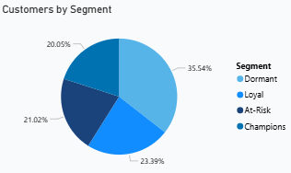
RFM SEGMENTATION
TOOL USED: SQL
Key Analyses:
RFM Metrics
Recency → Days since last purchase
Frequency → No. of purchases
Monetary → Total spend
RFM Scores (1–5) → Assigned using NTILE window function.
Customer Segments
Champions (≥2000), Loyal (800–2000), At-Risk(400–799), Dormant (<400).
👉 20% of customers are Champions (≥2000 spend), and contribute 80% of revenue.

Slide 7
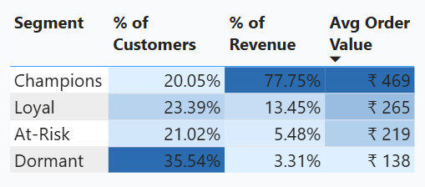
PARETO PRINCIPLE (80–20 RULE) ANALYSIS
Key Insights
Just 20% of our customers (Champions) generate over 78% of our revenue. (80-20 Rule)
Additionally, 15% of revenue comes from unknown customers and 85% comes from the registered users.
This highlights strong customer concentration — a small group drives the majority of sales.

Slide 8
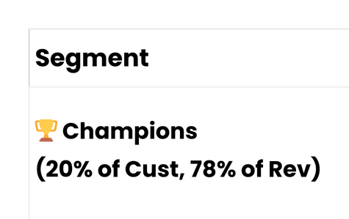
FROM INSIGHT TO ACTION: A SEGMENT-BY-SEGMENT PLAN

Slide 9
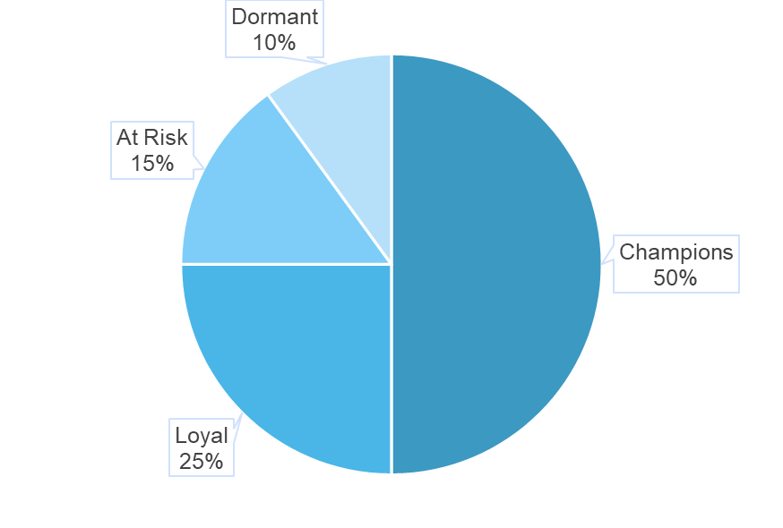
ALIGNING OUR SPENDING WITH OUR STRATEGY
50% - Champions (Retention):
VIP program costs, dedicated account manager time, high-quality content creation.
25% - Loyal Customers (Growth):
Loyalty program platform & rewards, targeted upsell campaigns.
15% - At-Risk (Win-Back):
Email marketing software, dedicated win-back campaign offers.
10% - Dormant (Re-engagement):
Low-cost mass email campaigns.
This model focuses on protecting our best customers (Champions) and growing the most promising segments, which increases overall marketing ROI.

Slide 10
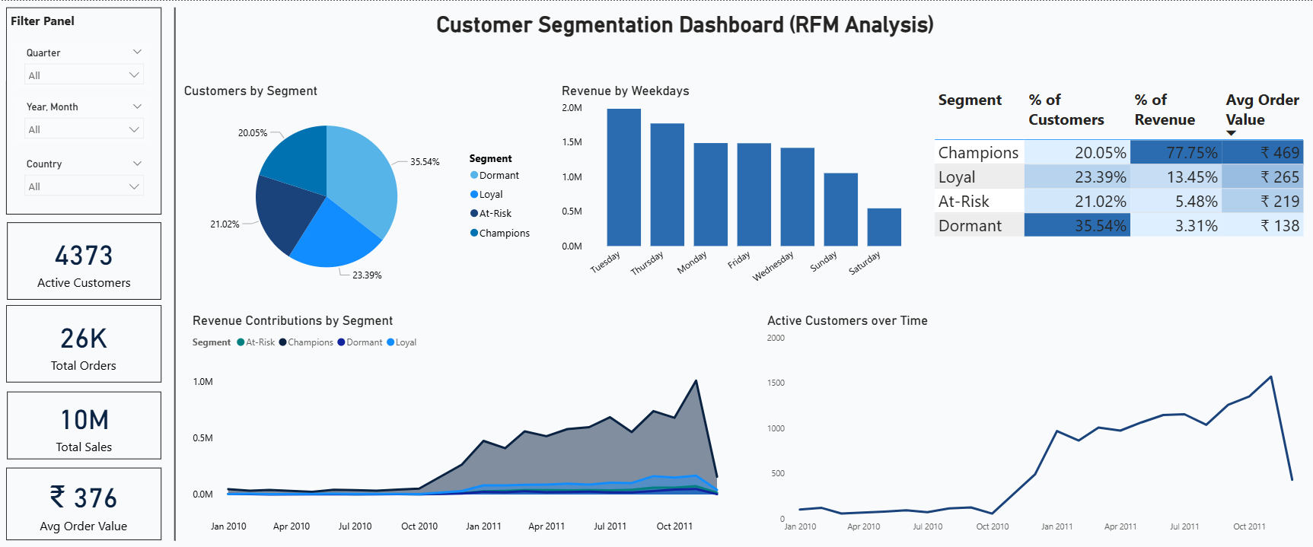
DASHBOARD
Interactive Dashboard Link

Slide 11

THIS IS THE ROADMAP TO BUILDING A MORE PROFITABLE, CUSTOMER-CENTRIC BUSINESS.
THANK YOU
ADITI JAIN

